Slide 1
SMART ALERT
GROUP 8
MACHINE LEARNING FOR DROWSINESS DETECTION
KIRAN PARASA
VISHAL KANAKAM
AMRITANSHU VIVEK
HANUMANTH YADAV D
HANUMANTHAGOUDA S D
FEDRIK SABU

Slide 2
ABSTRACT
About 40 percent of road accidents in India are caused by drowsiness of drivers. It is much high time now to bring upon some technology to mitigate the number of accidents caused by drowsiness. One such method is proposed here.
This project discusses on how detect eyes and yawning and alert the driver whether he is drowsy or not. The goal is to develop an AI-powered system that identifies driver states like "Open Eyes," "Closed Eyes," "Yawning," or "No Yawning," enabling real-time detection and prevention of potential hazards

Slide 3
DATASET
●Dataset Source:
Repository: https://www.kaggle.com/datasets/serenaraju/yawn-eye-dataset-new
Name: Yawn Eye Dataset (Kaggle)
Size: 2,400+ images divided into training and testing datasets.
Classes: Open Eyes(0), Closed Eyes(3), Yawning(2), No Yawning(1)

Slide 4
METHODOLOGY
Import necessary libraries.
Download the dataset.
Preprocess the data:
Resize images to a consistent size.
Balanced dataset classes to prevent model bias.
Normalized Image data for efficient training
Augmented data using techniques like horizontal flipping, rotation and zoom.
Split data into training, validation, and testing sets.

Slide 5
METHODOLOGY
Train the model:
Define the CNN model architecture.
Compile the model with an optimizer, loss function, and metrics.
Train the model using the training and validation data.
Evaluate the model:
Evaluate the model's performance on the test data.
Visualize the results using metrics and plots.
Save the model:
Save the trained model for future use.

Slide 6
METHODOLOGY
The project utilizes a CNN model built using Keras. The model architecture includes:
Convolutional layers with increasing filter sizes and ReLU activation.
Max pooling layers for downsampling.
Flatten layer to convert feature maps into a vector.
Dense layers for classification with ReLU activation.
Output layer with softmax activation for multi-class classification.

Slide 7
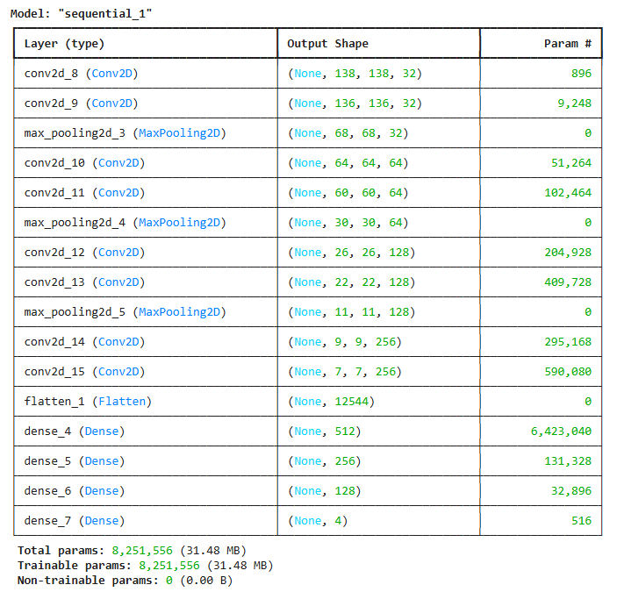
METHODOLOGY – MODEL SUMMARY

Slide 8
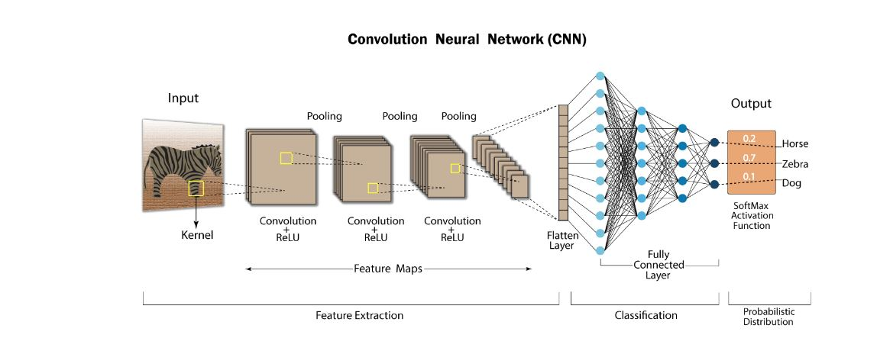
METHODOLOGY – SAMPLE DIAGRAM
NB: This image is just a diagram of code flow based on animal image detection dataset using CNN.

Slide 9
IMPLEMENTATION
Tools and Libraries:
Python, OpenCV, TensorFlow/Keras, Sklearn, Mediapipe
Real-Time Processing:
Video capture and frame-by-frame analysis.
Hardware:
Webcam or infrared camera setup.

Slide 10
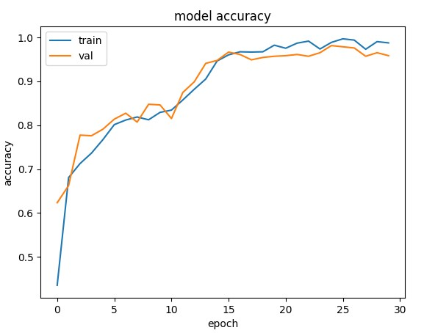
RESULTS – ACCURACY

Slide 11
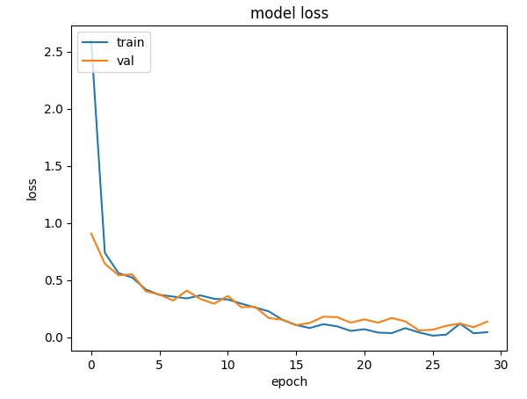
RESULTS – LOSS FUNCTION

Slide 12
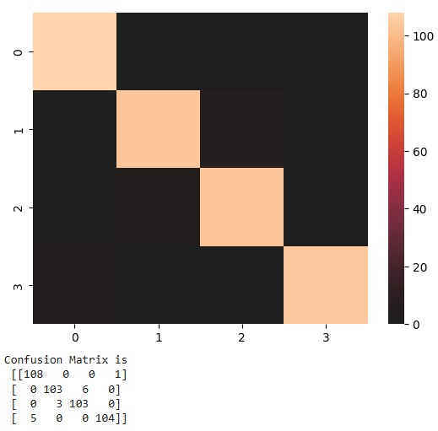
RESULTS – CONFUSION MATRIX
Open(0)
No_yawn(1)
Yawn(2)
Closed(3)

Slide 13
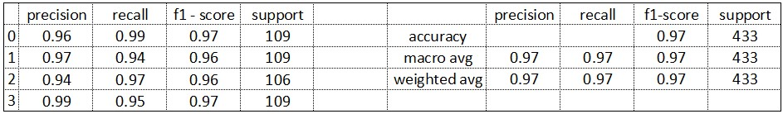
RESULTS – MODEL PERFORMANCE
Model Accuracy = 0.9653579676674365
Model Loss = 0.12754833698272705

Slide 14
APPLICATIONS
Primary:
Driver safety in automobiles.
Secondary:
Monitoring in other fields (e.g., pilots, heavy machinery operators).
Future Scope:
Integration with IoT devices, multi-modal systems (heart rate + eye tracking).

Slide 15
EXTRA MODELS
Based on the same methodology and dataset two separate models were made to detect eyes states and yawning.

Slide 16
CONCLUSIONS
Summary:
Achieved a real-time drowsiness detection system with significant accuracy.
Enhanced driver safety using machine learning.
Future Work:
Improve robustness in diverse conditions.
Reduce the computational cost and increase the accuracy.

Slide 17
ACKNOWLEDGEMENTS
Mentors and Guides:
Prof. Dr. Shashi Kumar Ganeshan, Divij Tirthankar Ghose and Thivin Anandh
Organizations:
CCE, IISc Bangalore.

Slide 18
THANK YOU

